Slide 1

DEPARTMENT OF COMPUTER SCIENCE AND ENGINEERING
PROJECT NAME : ENVIRONMENTAL MONITORING.
TEAM NAME : Proj_224786_Team_3
TEAM MEMBERS :
HARIKEERTHI.S(113321104025)
HARITHA.D(113321104027)
HEMALATHA.S(113321104028)
JANANI.M.A(113321104030)

Slide 2
Project Definition:
The Environmental Monitoring using IoT project aims to deploy a network of Internet of Things (IoT) devices to collect real-time data about various environmental parameters.
These parameters typically include temperature, humidity, air quality, pollution levels, soil moisture, and more, depending on the specific objectives of the project.
The collected data is then transmitted to a central database or cloud platform for analysis and visualization, enabling stakeholders to make informed decisions regarding environmental conservation, resource management, and public health.

Slide 3
Objectives:
1.Data Storage and Management:
Implement a database or cloud-based storage solution to securely store the incoming environmental data. Ensure data integrity, availability, and scalability.
2.Data Analysis and Visualization:
Develop analytical algorithms and visualization tools to process and present the collected data in a user-friendly format.
3.Alerting and Notifications:
Set up alerting mechanisms to notify relevant stakeholders when certain environmental thresholds or anomalies are detected.
4.Energy Efficiency:
Design the IoT devices and network to be energy-efficient to ensure long-term operation without frequent battery replacements or downtime.
5.Data Privacy and Security:
Implement robust security measures to protect the collected data from unauthorized access and ensure compliance with data privacy regulations.

Slide 4
6.Community Engagement: Involve local communities, government agencies, and environmental organizations to create awareness. 7.Environmental Impact Assessment: Use the collected data to assess the impact of human activities on the environment. 8.Research and Policy Support: Collaborate with researchers and policymakers to provide valuable data for scientific research and evidence-based decision-making in environmental policies. 9.Cost-Benefit Analysis: Evaluate the project's cost-effectiveness and potential economic benefits, such as improved public health or reduced resource wastage.

Slide 5
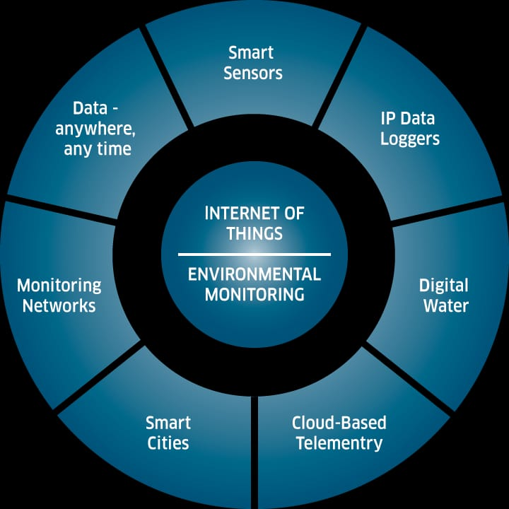
PROPOSED SYSTEM
In this proposed model the climatic changes are frequently monitoring through IOT using sensor nodes. Internet of Things (IoT) is a recent communication paradigm, in which the objects will be equipped with microcontrollers, transceivers and suitable protocol stack that will make them to communicate with one another and with user. This paper designs a prototype of wireless environmental monitoring system to upload information from array of sensors to the database. This application allows us to observe or measuring the environmental parameters from anywhere in real time. This system consist of main three modules namely sensor nodes, the wireless communication and the web server.

Slide 6
EXISTING SYSTEM
1 . Air Quality Index Monitoring: There are various systems available that measure air quality parameters like particulate matter, carbon monoxide, and ozone levels to provide real-time air quality information.
2. Water Quality Monitoring: Systems are in place to monitor water bodies for parameters such as pH, dissolved oxygen, turbidity, and pollutant levels to ensure water safety and identify potential issues.
3. Soil Moisture Monitoring: Sensors and probes are used to measure soil moisture content, helping farmers optimize irrigation and prevent water waste.
5. Noise Pollution Monitoring: Monitoring systems measure noise levels in urban areas to assess noise pollution and take measures to mitigate .

Slide 7
IoT Sensor Design
Temperature Sensors: climate control and preventing mold growth.
Air Quality Sensors: Detect pollutants like particulate matter (PM2.5 and PM10), carbon dioxide (CO2), volatile organic compounds (VOCs), and more, to assess indoor and outdoor air quality.
Gas Sensors: Detect specific gases like carbon monoxide (CO), methane (CH4), ozone (O3), and nitrogen dioxide (NO2) to assess air quality and safety.
Light Sensors: Measure light intensity or luminance, important for optimizing natural lighting and energy efficiency in buildings.
Noise Sensors: Monitor noise levels to assess noise pollution and its impact on the environment and human health.
Water Quality Sensors: Assess parameters such as pH, turbidity, dissolved oxygen, and conductivity in water bodies to monitor water quality.
Water Level Sensors: Monitor water levels in rivers, lakes, reservoirs, and tanks to manage water resources and flood control.
Humidity Sensors: Monitor the moisture content in the air, crucial for

Slide 8
Rainfall Sensors: Detect precipitation levels for weather forecasting and flood monitoring.
UV Sensors: Measure ultraviolet (UV) radiation to assess its impact on human health and the environment.
Radiation Sensors: Detect ionizing radiation in nuclear facilities and areas near nuclear accidents.
Camera Sensors: Use image sensors and cameras for visual inspection and surveillance in environmental monitoring.
GPS and Location Sensors: Provide location data for tracking the geographical distribution of environmental parameters.
Water Flow Sensors: Measure the flow rate of water in pipes and channels for water resource management.
Biological Sensors: Utilize biological sensors like biosensors to detect specific biological markers or organisms in the environment, such as bacteria or pollutants
Seismic Sensors: Detect ground vibrations and seismic activity for earthquake monitoring.

Slide 9
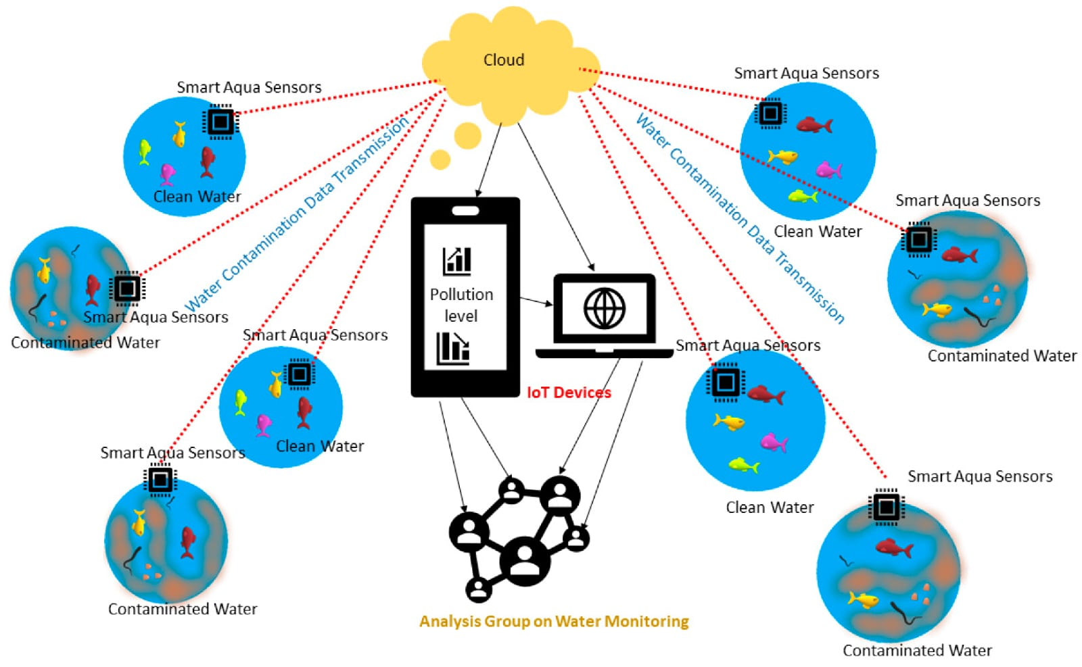

Slide 10
Real-Time Transit Information Platform:
Data Collection:
Set up IoT devices (sensors) to collect environmental data such as air quality, temperature, humidity, and pollution levels. These devices should be capable of transmitting data in real-time.
Data Transmission:
Ensure that the data from these IoT devices is transmitted securely and efficiently to a central server or cloud platform. MQTT or HTTP protocols are commonly used for this purpose.
Data Processing:
On the server/cloud, process the incoming data to clean, aggregate, and format it for analysis.
Translation Module:
Implement a translation module that can convert the collected environmental data into different languages in real-time. You can use machine translation APIs like Google Translate, Microsoft Translator, or custom-trained models for this purpose.

Slide 11
Alerts and Notifications:
Implement a system for generating alerts and notifications when environmental parameters exceed predefined thresholds. These alerts should also be available in multiple languages.
Data Visualization:
Use charts, graphs, and maps to visualize the environmental data. Make sure these visualizations can also be presented in different languages.
User Management:
Implement user authentication and authorization systems to control access to the platform. Users should be able to customize language preferences.
Security:
Pay special attention to the security of the IoT devices, data transmission, and storage. Use encryption and follow best practices to protect user data and the IoT network.
Testing and Optimization:
Thoroughly test the platform, optimize it for performance, and gather user feedback for improvements.

Slide 12
Integration Approach:
Integrating environmental monitoring with other disciplines and sectors is not a one-size-fits-all process, as the context, purpose, and scope of the project or program will dictate the approach.
However, some general steps and principles can guide the integration process.
This includes defining the problem or opportunity, identifying relevant disciplines and sectors, establishing a common framework and language for data collection and analysis, engaging stakeholders throughout the process, applying appropriate methods and tools to integrate data and outputs, evaluating outcomes and impacts, and sharing lessons learned.
These steps will help ensure a successful integration of environmental monitoring with other disciplines and sectors.

Slide 13
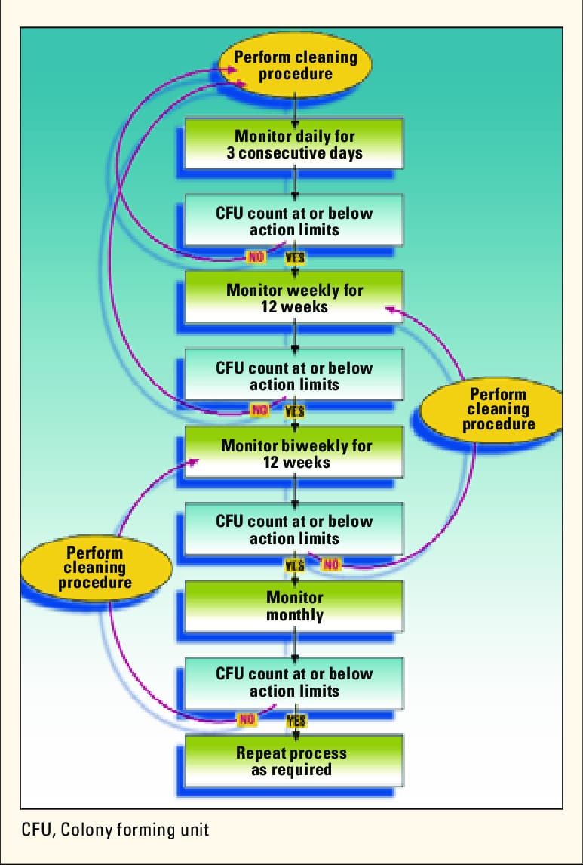
FLOWCHART

Slide 14
EXAMPLES OF INTEGRATION:
.
For example, remote sensing, geographic information systems, and participatory mapping can be used to monitor land degradation and restoration.
Hydrological, ecological, and socio-economic indicators can be combined to monitor water quality and quantity. Climate, biodiversity, and health data can be integrated to monitor the impacts of climate change on human and ecosystem health.
Natural capital accounting, ecosystem services valuation, and green economy modeling can all be used to monitor the benefits and costs of natural resource management.
Finally, citizen science, social media, and mobile applications can be employed to monitor environmental awareness and behavior.

Slide 15
INNOVATION
IoT Sensors: Internet of Things (IoT) devices are used to collect data on air quality, water quality, and other environmental factors in real time.
Machine Learning: ML algorithms analyze vast datasets to predict environmental trends, such as climate modeling and species population changes.
Remote Sensing Technologies: Satellite and drone-based remote sensing provide high-resolution data for monitoring changes in land use, deforestation, and more.
Citizen Science Apps: Smartphone apps empower citizens to participate in data collection and reporting on local environmental issues.

Slide 16
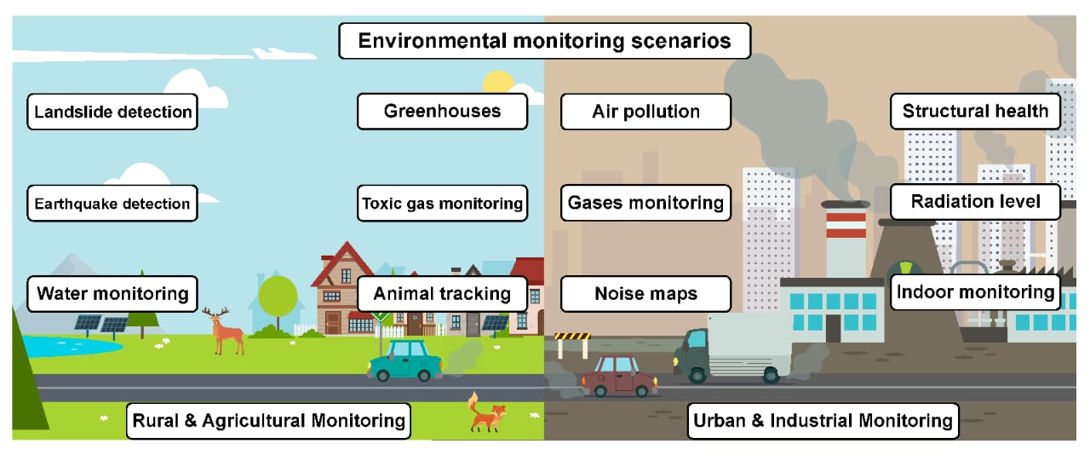

Slide 17
BENEFITS
1. Early Detection of Issues: Monitoring helps identify environmental issues such as pollution, climate change, or natural disasters early on, allowing for timely intervention and mitigation.
2. Protection of Ecosystems: Monitoring helps in understanding the health of ecosystems, enabling conservation efforts, and ensuring the preservation of biodiversity and natural habitats.
3. Sustainable Resource Management: Monitoring natural resources like water, soil, and forests helps ensure their sustainable use, preventing overexploitation and promoting conservation practices.
4. Public Health and Safety: Monitoring air and water quality helps protect public health by identifying potential hazards and implementing measures to minimize risks and exposure to pollutants.

Slide 18
CONCLUSION
The IOT based Environmental Monitoring System has been designed and implemented. The Environmental parameters successfully transmitted via ESP 8266 Wi-Fi module. The density of the gases in the remote located area viewed through the ThingSpeak web server. This project will protect the people from the pollutant gases. It is more useful for the Industries to control the air pollution in the surrounding area and for the workers safety. In future we can implement this project with ESP 8266-12E Wi-Fi module and with the sensors which can sense the gas density in high level. ESP 8266-12E module has inbuilt Arduino microcontroller. It reduces the overall size of the device and simplifies the working.

Slide 19


